Slide 1


DEPARTMENT OF AUTOMOBILE ENGINEERING
MIT CAMPUS, ANNA UNIVERSITY, CHENNAI – 44
FINAL REVIEW – PHASE 2
EXPERIMENTAL ANALYSIS OF PERFORMANCE,COMBUSTION AND EMISSION CHARACTERISTICS OF SINGLE CYLINDER DIESEL ENGINE USING BIOFUEL(DIESEL-TURPENTINE BLEND) WITH HYDROGEN INDUCTION.
S.NO | Name | Register Number
1 | NIROSHINI. K | 2019502032
2 | AKILAN. S | 2019502509
3 | DHINESH BABU. R | 2019502517
4 | HARI VIGNESH. N S | 2019502523
GUIDE:
Dr. A.Sangeet Sahaya Jeyangel,
Teaching Fellow,
Department of Automobile Engineering,
MIT campus, Anna university

Slide 2
INTRODUCTION
Entire worldwide, fossil reserves are getting scantier and progressively exorbitant with time.
Moreover, constant dependency on them leads to the frightening plight of global warming. Higher fuel prices and limited natural resources have forced the researchers to pursue research on green alternative fuels.
The use of biofuel obtained from plants in internal combustion engine is finding its place to replace the use of conventional fuel. In our research, the performance, combustion and emission characteristics of diesel engine fueled with biofuel (diesel-turpentine blend) with hydrogen induction.

Slide 3
LITERATURE SURVEY
SI NO | JOURNAL NAME | YEAR | TOPIC | AUTHORS | INFERENCE
1 | Elsevier | 2019 | Experimental study on the effect of cetane improver with turpentine oil on CI engine characteristics | A.K.Jeevanantham, D.Madhusudan reddy,B.Ashok, Aman kumar | A novel cetane improver called SC5D is added with 20% blend of turpentine with diesel. For higher Nox emission condition,10% of EGR is applied. At this condition, unburned HC and smoke emissions are remarkably lower.
2 | Researchgate | 2017 | A review on novel bio-fuel from turpentine oil | Mehmet Hakki Alma, Tufan Salan | At 40% blend of turpentine oil with diesel mixture shows 2.5% increase in BTE than the diesel. nearly 50% smoke was reduced but a little shoot and co was found.

Slide 4
SI NO | JOURNAL NAME | YEAR | TOPIC | AUTHORS | INFERENCE
3 | Elsevier | 2018 | Influences of dual bio-fuel (Jatropha biodiesel and turpentine oil) on single cylinder variable compression ratio diesel engine | Pankaj Dubey, Rajesh Gupta | Experiments have been accompanied at CR of 15.5:1,17:1,18.5:1 and 20:1. Biofuel blend (JBT50) resulted at full load and CR 20:1,there was 2.17% increase inBTEand13.04%,17.5%,4.21% and 30.8% decrease in CO,HC, NOx and smoke and 11.04% increase in CO respectively.
4 | Elsevier | 2010 | Performance and exhaust emission of turpentine oil powered direct injection diesel engine | B. Prem Anand, C.G. Saravanan, C. Ananda Srinivasan | 30% of turpentine oil blend with diesel produce high brake power and net heat release rate with a net reduction in CO,HC,Nox,smoke and particulate matter. 40% and 50% blends produce lower brake power.

Slide 5
SI NO | JOURNAL NAME | YEAR | TOPIC | AUTHORS | INFERENCE
5 | Elsevier | 2019 | Control of backfire and NOx emission reduction in a hydrogen fueled multi-cylinder spark ignition engine using cooled EGR and water injection strategies. | Vipin dhyani,K.A. Subramanian. | The experimental test was conducted on a engine with varied EGR rate (0% - 28% volume) and water to hydrogen ratio (0-9.25) at 15kW load It was found that at 25% EGR,there was 57% reduction in Nox,with WHR of 7.5, the Nox emission was reduced by 97% without affecting the efficiency.
6 | Elsevier | 2011 | Hydrogen effects on Nox emissions and brake thermal efficiency in a diesel engine under low-temperature and heavy –EGR ondition. | Buomsik shin,Youngsoo cho,Daeha han,Soonho song | The experiment was observed over a constant EGR ratios of 2,16 and 31%. The Nox reduction due to hydrogen addition increased at higher EGR ratio. At 31% EGR ratio,the Nox was lowered by 25% and a slight increase in brake thermal efficiency.

Slide 6
RESEARCH GAP
A review on novel bio-fuel from turpentine oil by Mehmet Hakki Alma, Tufan Salan (2017) - has discussed about the use of 40% of turpentine oil blend with diesel in diesel engine.
Influences of dual bio-fuel (Jatropha biodiesel and turpentine oil) on single cylinder variable compression ratio diesel engine by Pankaj Dubey, Rajesh Gupta (2018) – has discussed about the use of jatropha and turpentine oil blend in single cylinder diesel engine.
But so far no one has explored the arena of using hydrogen induction with turpentine blend with diesel and analyzing the performance, combustion and emission characteristics of single cylinder ci engine.

Slide 7
AIM & OBJECTIVE
AIM
To experimentally test the performance , combustion , emissions characteristics of single cylinder diesel engine using biofuel.
OBJECTIVE
Objective is to compare the characteristics of biofuel blends (diesel-turpentine) and the same with hydrogen induction for the best two blends (B20 and B30).

Slide 8
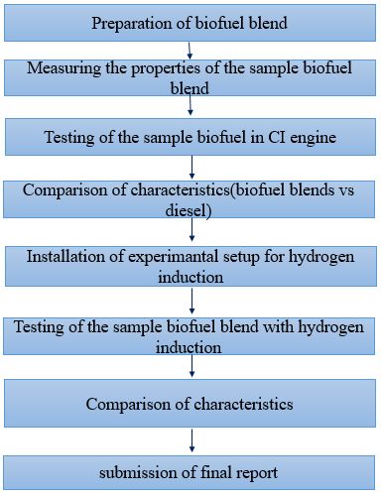
METHODOLOGY

Slide 9
WHY TURPENTINE OIL?
Turpentine oil is physically a yellowish, opaque, odorous and water-immiscible liquid when it is chemically flammable,volatile and combustible.
Turpentine oil is mixture of α- and β- pinenes(30% and 60% respectively) and other isometric terpenes.
Turpentine oil is extracted from the resin of pine tree(genus pinus) saps and leaves.
Turpentine oil having low viscosity and lower carbon resides and environmentally friendly due to its low Sulphur content Also, the properties of turpentine oil are similar with diesel.

Slide 10
PROPERTIES OF FUEL
BLEND | DENSITY(g/m³) | KINEMATIC VISCOSITY ( m²/s) | FLASH POINT (°c) | FIRE POINT (°c) | CALORIFIC VALUE(KJ/Kg)
DIESEL | 0.827 | 13.28 | 47 | 54 | 42500
B20 | 0.831 | 14.567 | 49 | 55 | 42880
B30 | 0.835 | 14.147 | 52 | 57 | 43070
B40 | 0.839 | 13.360 | 55 | 60 | 43260
B50 | 0.844 | 13.055 | 57 | 62 | 43450
TURPENTINE | 0.845 | 10.870 | 53 | 58 | 44400

Slide 11
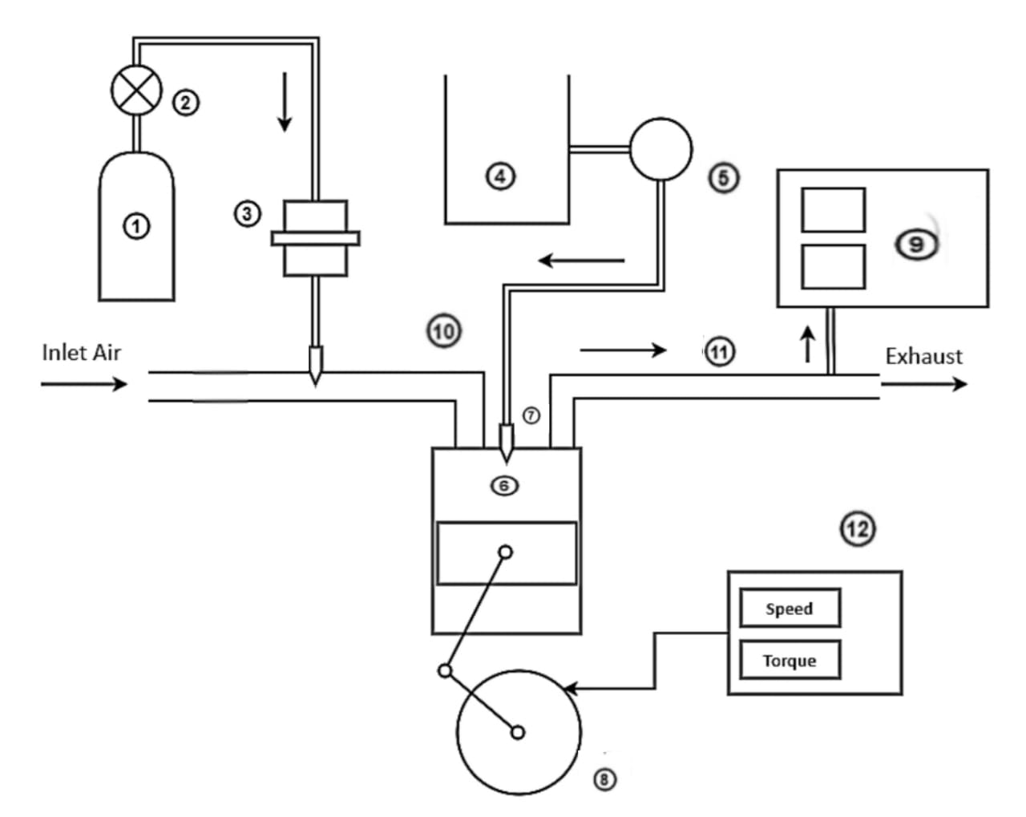
ENGINE SETUP LAYOUT
① - Hydrogen Storage Tank
② - Pressure Regulator
③ - Flame Arrestor
④ - biodiesel-Diesel blend tank
⑤ - Fuel Pump
⑥ - Diesel Engine
⑦ - Fuel Injector
⑧ - Crank Wheel
⑨ - Exhaust Gas Analyzer
⑩ - Inlet Manifold
⑪ - Exhaust Manifold
⑫ - Dynamometer

Slide 12
ENGINE SPECIFICATIONS
S.NO | PARAMETERS | SPECIFICATIONS
1. | General Details | Single cylinder , Four stroke , compression ignition , constant speed , , water cooled , direct injection
2. | Bore length | 87.5 mm
3. | Stroke length | 110 mm
4. | Swept volume | 661 cc
5. | Dynamometer | Type eddy current, water cooled
6. | Compression ratio | 17.5:1
7. | Rated output | 5.2 KW at 1500 rpm
8. | Fuel tank capacity | 15 liters
9. | Make | Kirloskar

Slide 13
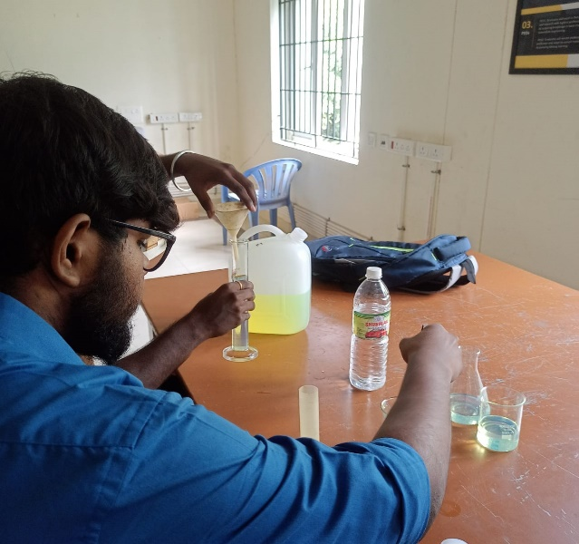
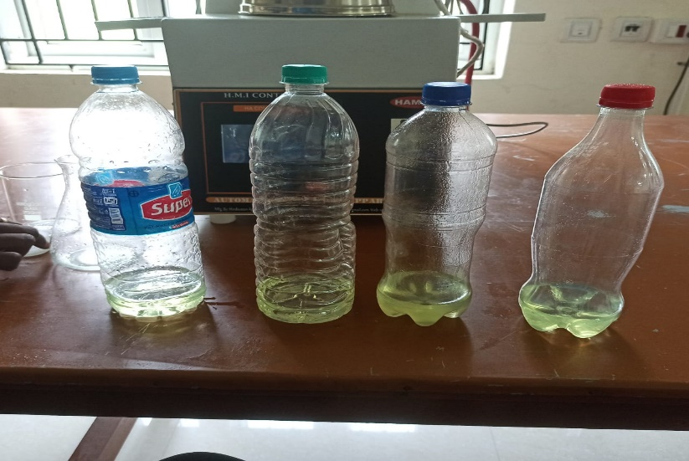
PREPARATION OF BIOFUEL BLEND
From the result of phase 1, we choose 2 blends (B20 and B30) from the 4 blends (B20,B30,B40 and B50).
These two blends were taken based on their brake thermal efficiency of 31% for B20 blend and 30% for B30 blend at full load (100%) when compared to the other blends.

Slide 14
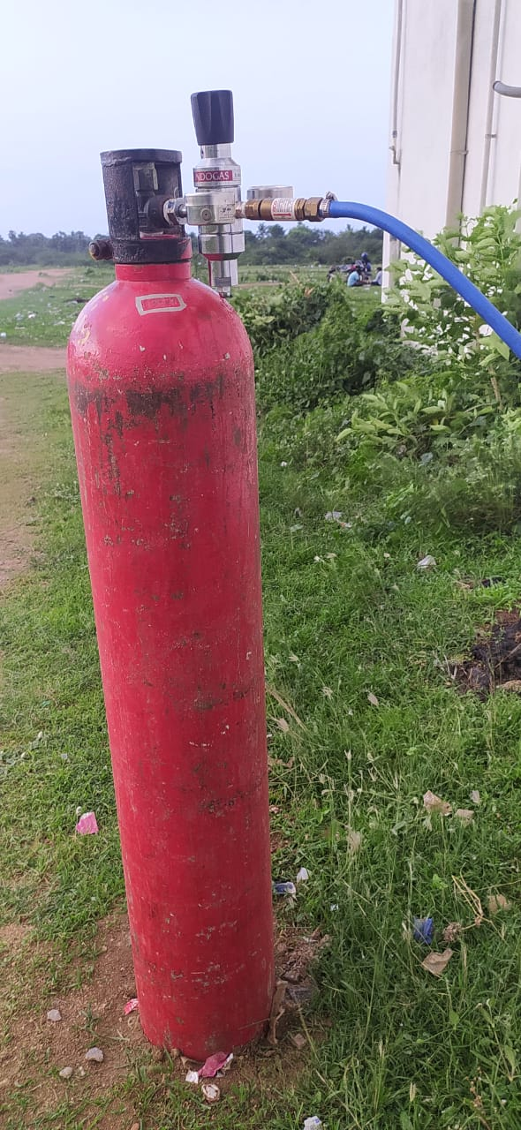
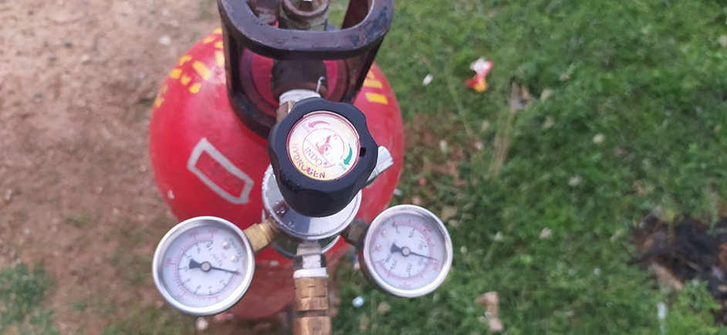
INSTALLATION OF HYDROGEN INDUCTION SETUP
HYDROGEN CYLINDER:
Hydrogen is stored in a
Metallic cylinder in a
compressed Gaseous state.
Hydrogen was stored
Under the pressure of 260
bar for this project.
PRESSURE REGULATOR:
A pressure regulator is a valve that controls the pressure of a fluid or gas to a desired value, using negative feedback of controlled pressure.

Slide 15
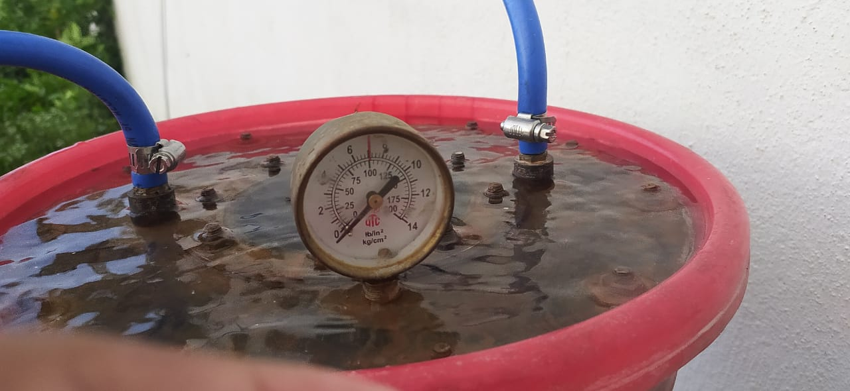
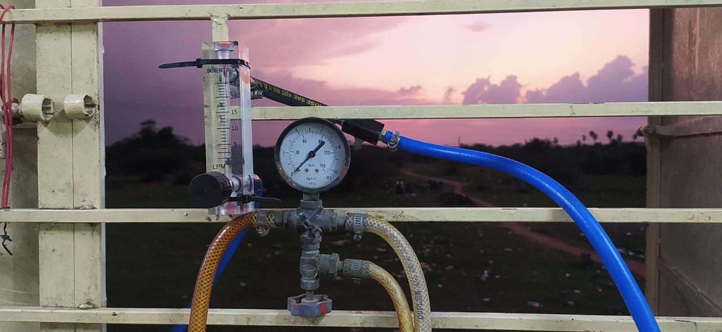
INSTALLATION OF HYDROGEN INDUCTION SETUP
FLAME TRAP:
A flame trap or flame arrestor is used to arrest backfire in H₂ supply line which reduces the risk of explosion
FLOW METER:
Flowmeter is connected next to flame trap to measure the flow of hydrogen.it measures the supply of hydrogen gas in litre per minute (LPM)

Slide 16
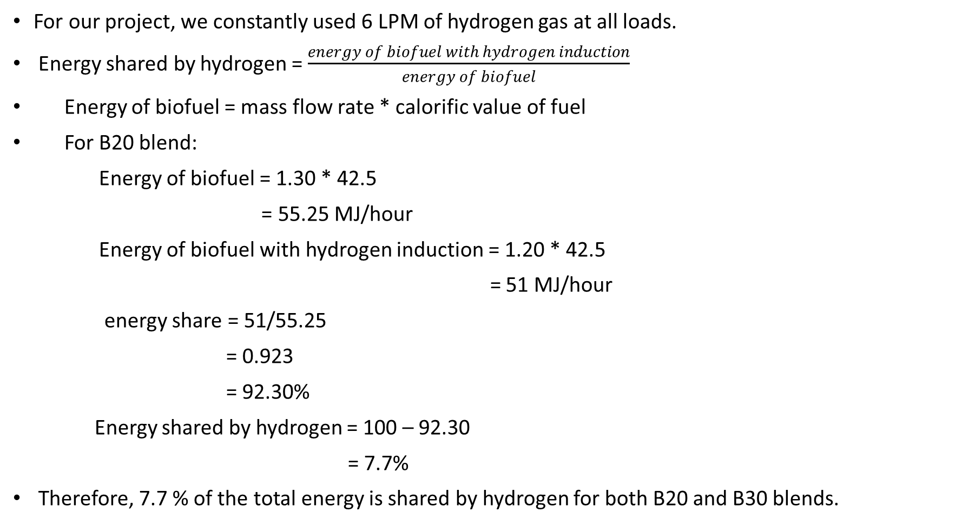
ENERGY SHARE CALCULATION
For our project, we constantly used 6 LPM of hydrogen gas at all loads.
Energy shared by hydrogen = $\frac{energy of biofuel with hydrogen induction}{energy of biofuel}$
Energy of biofuel = mass flow rate * calorific value of fuel
For B20 blend:
Energy of biofuel = 1.30 * 42.5
= 55.25 MJ/hour
Energy of biofuel with hydrogen induction = 1.20 * 42.5
= 51 MJ/hour
energy share = 51/55.25
= 0.923
= 92.30%
Energy shared by hydrogen = 100 – 92.30
= 7.7%
Therefore, 7.7 % of the total energy is shared by hydrogen for both B20 and B30 blends.

Slide 17
PERFORMANCE CHARACTERISTICS
INFERENCE:
BTE is less when using biofuel, because of the poor volatility, lower energy content and inferior combustion characteristics of the biofuel.
The high flame velocity of the hydrogen, which is added to the intake air increases the combustion rate during combustion. This results in higher BTE. The BTE of B20H₂ was 33% and B30H₂ was 32% at 100% load.
Therefore 2% increase in BTE was achieved.

Slide 18
SPECIFIC FUEL CONSUMPTION
INFERENCE:
The biofuel has higher viscosity than the diesel, which leads to increased friction and energy losses within the engine.so the SFC increase for the biofuel blends.
Hydrogen addition decreases SFC of the engine due to the superior combustion characteristics of the fuel mixture along with hydrogen.
The high flame velocity will increase the combustion rate and this in turn reduces SFC

Slide 19
COMBUSTION CHARACTERISTICS
INFERENCE:
Due to the lower energy content of the biofuel blends ,the combustion process does not produce as much energy per unit volume or mass, which leads to the lower pressure generation.
The superior properties and the higher flame velocity of the hydrogen results in complete oxidation of premixed charge that significantly increase the cylinder’s pressure.

Slide 20
HEAT RELEASE RATE
INFERENCE:
The biofuel releases less heat compare with diesel, due to the low energy content and inferior combustion properties of biofuel blends.
The increased ignition delay of the hydrogen improves the combustion. Hence the heat release rate with hydrogen enrichment will be higher

Slide 21
EMISSION CHARACTERISTICS
INFERENCE:
More amount of oxygen content and lower carbon molecules of the biofuel will result in reduction in CO emissions.
The hydrogen molecules will react with the oxygen present in biofuel will form OH molecules.
This improves the combustion process and reduces the formation of CO emission in the exhaust.
At 100% load, the CO emissions of B20H₂ and B30H₂ were 191% and 110% respectively.

Slide 22
HC Vs LOAD
INFERENCE:
Biofuel contains lower cetane number will increase the ignition delay and slower combustion and leads to increase in HC emission.
The rapid burning rate of the hydrogen fuel will result in higher combustion rate and decreases HC emissions.
At 100% load, the HC emissions of B20H₂ and B30H₂ were 70 ppm and 41 ppm respectively.

Slide 23
NOx Vs LOAD
INFERENCE:
The increase in NOx emissions while using biofuel is due to the presence of more oxygen molecules which results in complete combustion and increase in in-cylinder temperature.
Higher calorific value of hydrogen fuel will release more heat energy during combustion, which also increases peak temperature. Hence hydrogen enrichment will result in more NOx emissions
At 100% load, the NOx emissions of B20H₂ and B30H₂ were 2513ppm and 2678 ppm respectively.

Slide 24
SMOKE Vs LOAD
INFERENCE:
The biofuel has higher oxygen content that enhances the combustion rate and improves the oxidation of the fuel mixture. This reduces the formation of smoke.
The addition of hydrogen increases the combustion by secondary oxidation and burns the unburned particles. This reduces the smoke opacity.
At 100% load, the smoke emissions of B20H₂ and B30H₂ were 50% and 45% respectively.

Slide 25
CONCLUSION
In this project, the effect of turpentine oil biofuel with hydrogen induction in single cylinder diesel engine its effect on performance, combustion and emission characteristic was studied. The following conclusions were derived:
The brake thermal efficiency in CI engine has decreased with the Turpentine-diesel blend. This was due to the low heating capacity of the turpentine-diesel blends. The BTE of B20 and B30 blend was found as 31% and 30% respectively The BTE was increased when induction with hydrogen. The BTE of B20 blend with hydrogen induction was 33% causing a 2% increase in BTE.
The specific fuel consumption was increased for the diesel-turpentine blends than the diesel, but the induction of hydrogen decreases the SFC for the B20 and B30 blends.
The Diesel when compared to the biofuel blends produces a higher in-cylinder pressure and heat release rate due to the higher flame velocity and good combustion rate. Also when using hydrogen, the combustion pressure and the net heat release rate of the biofuel blends was increased due to superior combustion characteristics of hydrogen.

Slide 26
CONCLUSION
The CO emissions of the biofuel blends were reduced. At full load, the CO was found to be 285% and 276% for B20 and B30 blends respectively. With hydrogen induction, the CO was found to be 191% and 110% for B20 and B30 blend.
At low load, the biofuel blends shows decrease in NOx emissions. At low load, the NOx was found to be 121 and 95 ppm for B20 and B30 blend. At full loads with induction of hydrogen increases the NOx emissions drastically. The NOx at full load with hydrogen induction for B20 and B30 blends were 2513 ppm and 2678 ppm.
The smoke and HC emissions of the biofuel blends with hydrogen induction were decreased when compared to the other biofuel blends. At full loads, the smoke percentage for B20 and B30 with hydrogen induction were 50% and 45% respectively and the percentage of HC was 70% and 41% respectively

Slide 27
THANK YOU

